Slide 1

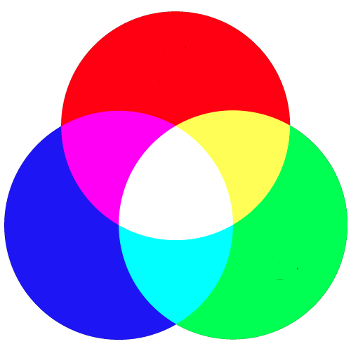
Understanding Color
In electronic systems, color specified using the RGB color model
Red, Green, Blue
Each pixel on your screen is made up of 3 tiny lights, one red, one green, one blue
Specify the intensity of each light using an integer between 0 and 255
0 is completely off
255 is highest intensity
Notes:
We can mix intensities of red, green, blue to get many different colors
Specify intensity with a single byte (0 off --- 255 all the way on)

Slide 2

Guess the Color
Color( R, G, B);
Color(255, 0, 0);
Color( 0, 255, 0);
Color( 0, 0, 255);
Color( 0, 0, 0);
Color(255, 255, 255);
Color(255, 255, 0);
Color(255, 0, 255);
Color( 0, 255, 255);
// red
// green
// blue
// black
// white
// yellow
// magenta
// cyan
Notes:
Have students answer each
---
We won’t require you to memorize this (can look it up) but it will be handy to understand its usage!
So, how can we use this?

Slide 3

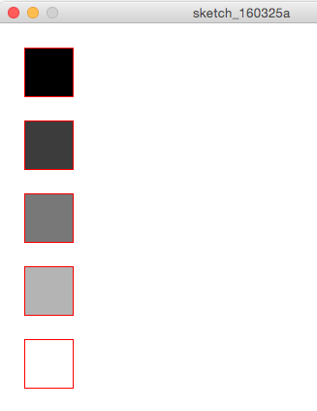
50 Shades of Gray….
(0,0,0)
(60,60,60)
(120, 120, 120)
(180, 180, 180)
(255, 255, 255)
When the values for RGB are all the same, then the color will be white, black, or some shade of gray
Notes:
Annotate: darker to lighter
If you make all the values the same, then you’ll just get shades of grey.

Slide 4
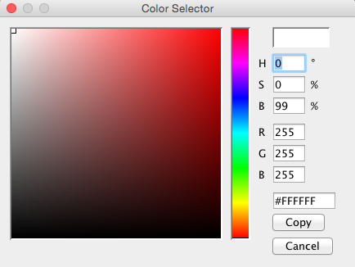
Typical Color Selector
What’s #FFFFFF?
To save space we store colors using 1 memory space instead of 3.
That is every color is really just a 32 bit integer.
#FFFFFF
Notes:
What do they go to 255? 8 bits.
Where’s the other 8 bits? Used for transparency. Really 00FFFFFF
0 fully trans parent, 255 fully opaque

Slide 5
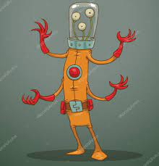
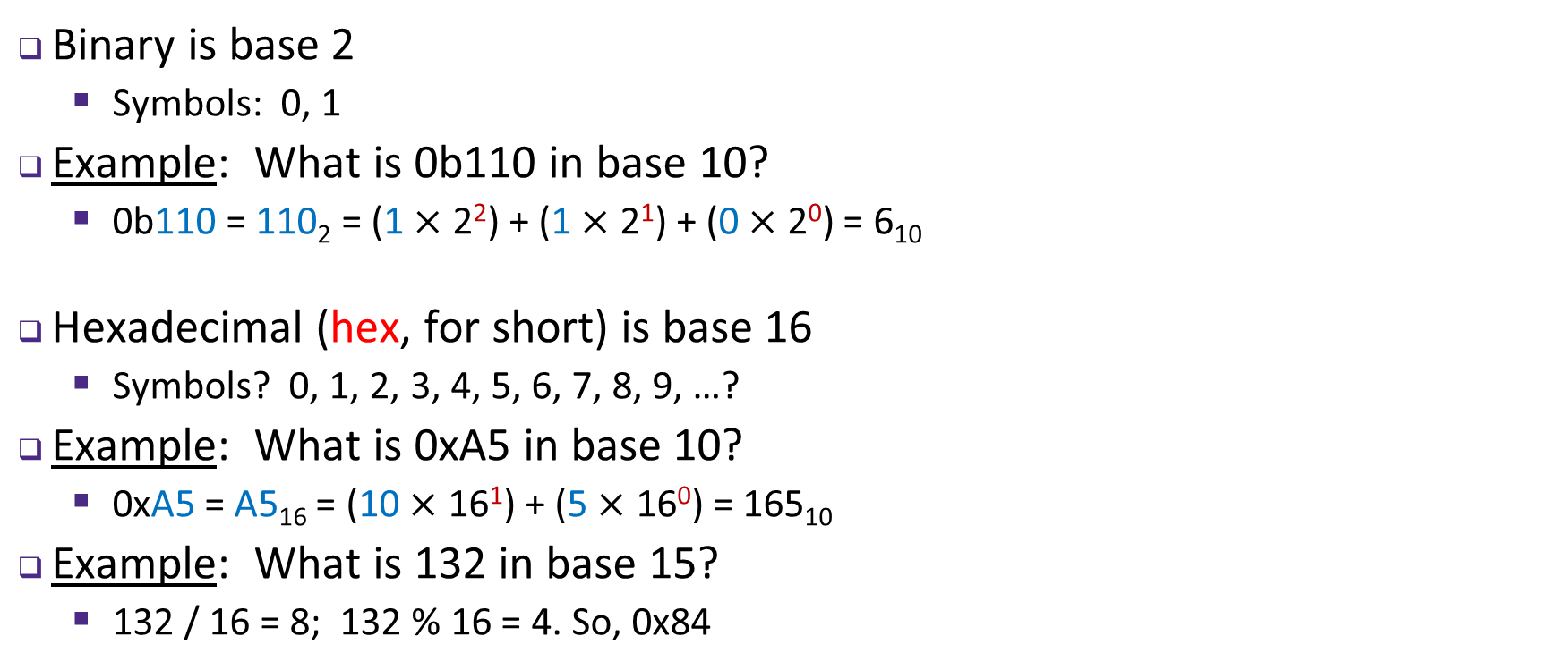
Binary and Hexadecimal
Binary is base 2
Symbols: 0, 1
Example: What is 0b110 in base 10?
0b110 = 110₂ = (1 $×$ 2²) + (1 $×$ 2¹) + (0 $×$ 2⁰) = 6₁₀
Hexadecimal (hex, for short) is base 16
Symbols? 0, 1, 2, 3, 4, 5, 6, 7, 8, 9, …?
Example: What is 0xA5 in base 10?
0xA5 = A5₁₆ = (10 $×$ 16¹) + (5 $×$ 16⁰) = 165₁₀
Example: What is 132 in base 15?
132 / 16 = 8; 132 % 16 = 4. So, 0x84
9, A, B, C, D, E, F
Notes:
Computers typically use binary and hexadecimal. Binary is just base 2 – we only have 0 and 1!
Annotate: can use subscript 2, or prefix ”0b” means the same thing “zero bee”
Same procedure as hex to convert, but now we have 1’s, 2’s, 4’s.
Annotate: 2^2 = 4, 2^1 = 2, 2^0 = 1 (but it’s a zero, so don’t count it)
Hexadecimal is also often used for computers
Ask: where can we get the extra numbers that we want?
Annotate: 10 → a, 11 → b, etc.
Annotate: “0x” or “zero ex”
Same procedure, but now we have to associate symbol with value
With A in 16’s position, corresponds to 10 * 16^1

Slide 6

Base Comparison
Base 10 | Base 2 | Base 16
0 | 0000 | 0
1 | 0001 | 1
2 | 0010 | 2
3 | 0011 | 3
4 | 0100 | 4
5 | 0101 | 5
6 | 0110 | 6
7 | 0111 | 7
8 | 1000 | 8
9 | 1001 | 9
10 | 1010 | A
11 | 1011 | B
12 | 1100 | C
13 | 1101 | D
14 | 1110 | E
15 | 1111 | F
Why does this matter?
Humans think about numbers in base 10, but computers “think” about numbers in base 2
Binary encoding is what allows computers to do all the amazing things that they do!
Example: Hex to Binary Trick: 2^4 = 16
0xB4 = _ _ _ _ _ _ _ _
Notes:
Annotate: decimal, binary, hex; each row is equivalent in value, different representations

Slide 7

So, What’s It Mean?
A sequence of bits can have many meanings!
Consider the hex sequence 0x4E6F21
Common interpretations include:
The number 5140257
The characters “No!”
The background color of this slide
The real number 7.203034 $×$ 10⁻³⁹
It is up to the program/programmer to decide how to interpret the sequence of bits
Notes:
Well… it depends.
Numbers aren’t really useful without context.

Slide 8
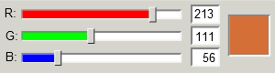
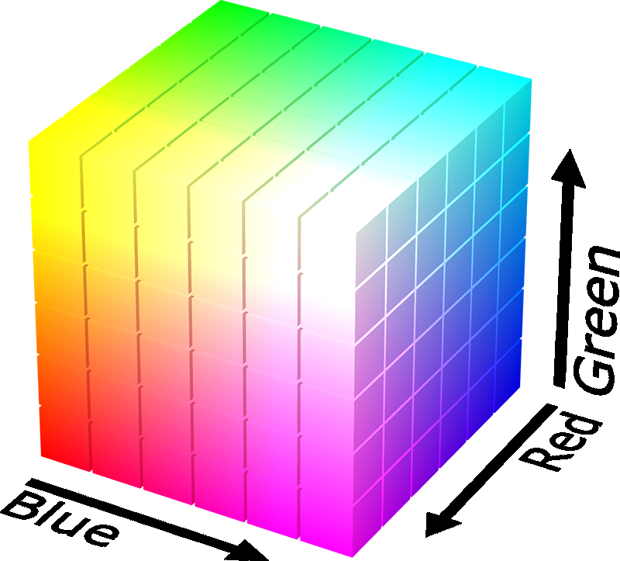
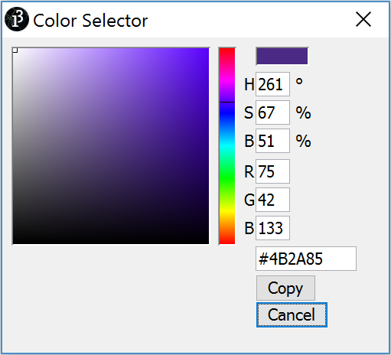
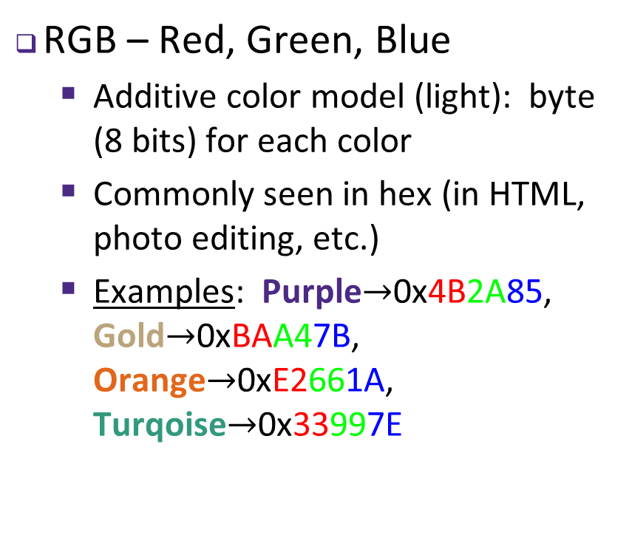
Binary Encoding – Colors
RGB – Red, Green, Blue
Additive color model (light): byte (8 bits) for each color
Commonly seen in hex (in HTML, photo editing, etc.)
Examples: Purple$→$0x4B2A85, Gold$→$0xBAA47B, Orange$→$0xE2661A, Turqoise$→$0x33997E
Notes:
0x00 -> 0xFF (0 – 255)
Work through examples
- Purple to RGB -> 4B = 4*16+11; 2A = 2*16+10; 85=8*16+5

Slide 9
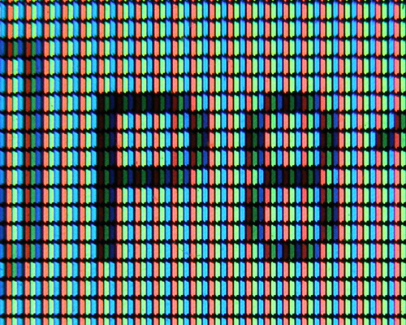
Images
An image is just a 2-dimensional set of pixels
The image has a width and a height
Each pixel has an associated (RGB) color
In Java, one way to represent an image is as a double array of int data
BufferedImage Class
Notes:
Annotate a couple of pixels: black, white
Annotate ← width → and ^ \/ height

Slide 10
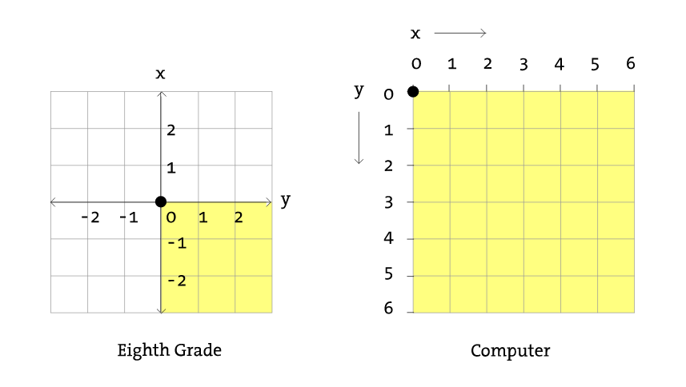
Coordinate System for Images
Math
Images
y
x
Notes:
How do we specify positions on the drawing canvas?
typically, origin is in the middle
X/Y positive/negative in each direction
For computers, we’d like the origin to not move
Origin is always upper-left corner
Y increases top down
No more negative numbers

Slide 11
Representation
Width, Height?
Pixels: W – white pixel, B – black pixel
WWWWWW BBBBBB BWWWWB BWWWWB BBBBBB WWWWWW
W = 0xFFFFFF
B = 0x000000
Notes:
How can we reduce the size of this data without losing any information?

Slide 12
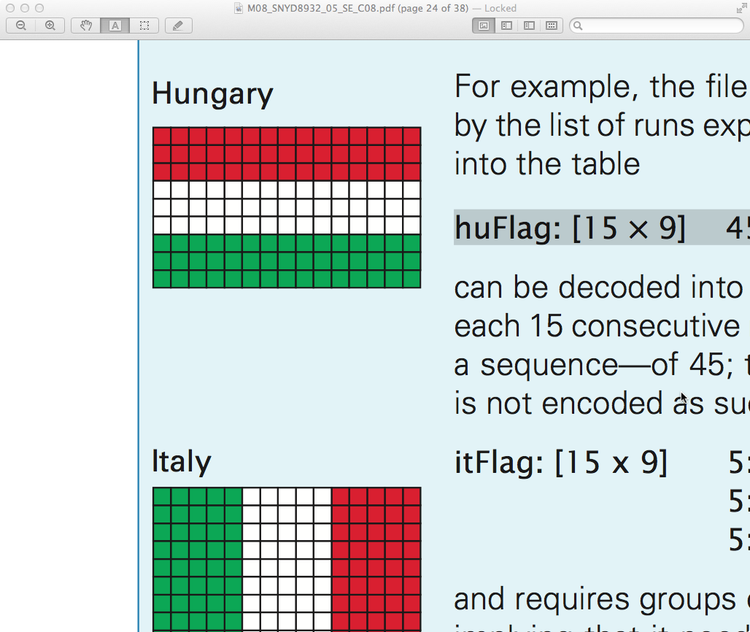
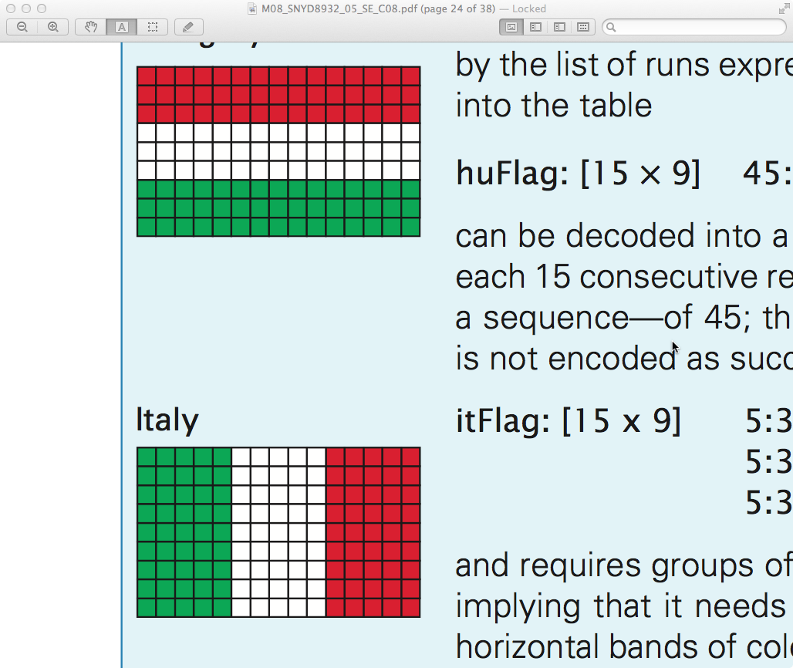
Representation
Width, Height?
Pixels: W – white, R – red, G – green
R = (205,33,42) = 0xCD212A
G = (0, 140, 69) = 0x008C45
W = (255,255,255) = 0xFFFFFF
Notes:
How can we reduce the size of this data without losing any information?

Slide 13
Color as Data in Java
Recall: all data on a computer is stored using binary encoding
Including colors, though we won’t cover exactly how
Java has a Color Object
Color color = new Color( this.pixels[x][y]); // takes any integer
int red = color.getRed(); // integer between 0 and 255
int blue = color.getBlue();
int green = color.getGreen();
Notes:
Example: if pixel is 0x21FA83

